Slide 1


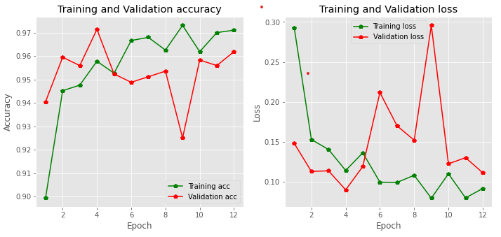
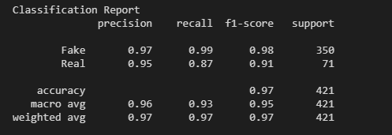
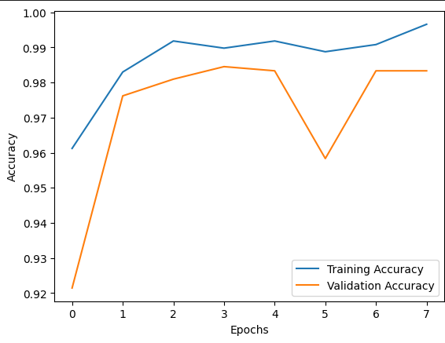
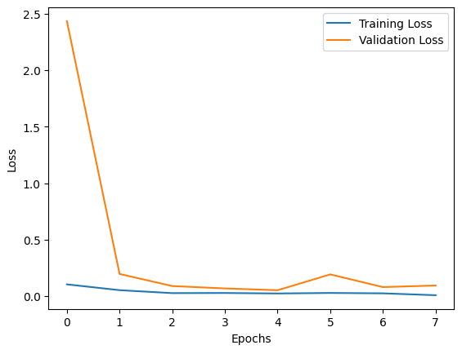
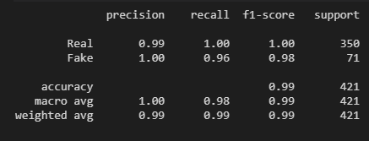
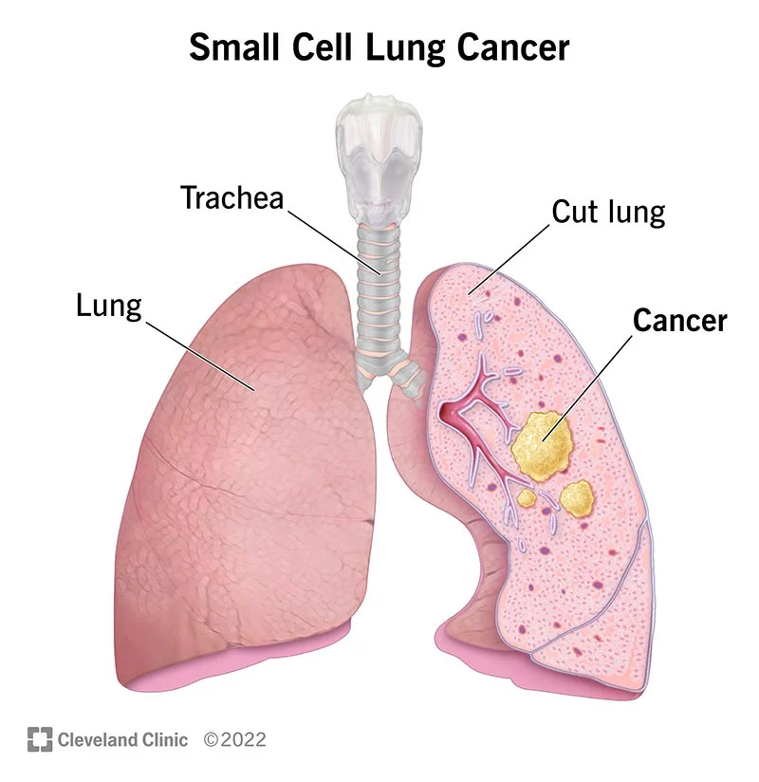
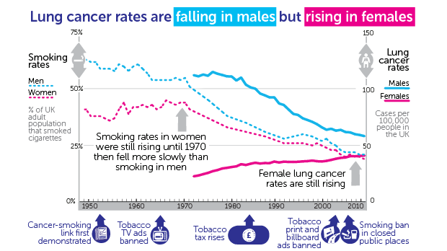
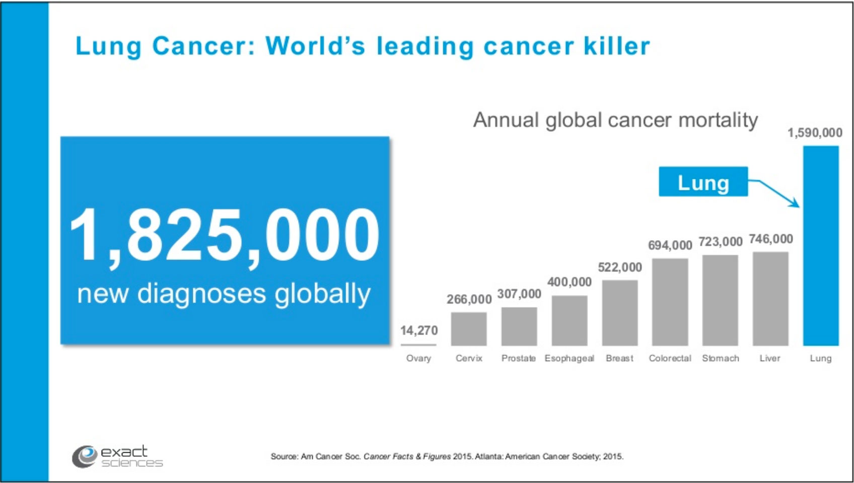
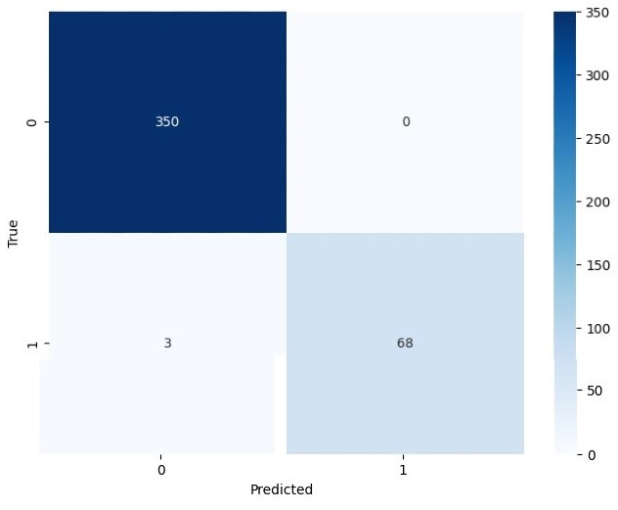
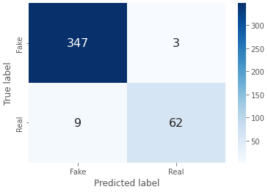
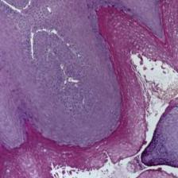
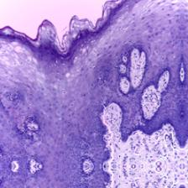
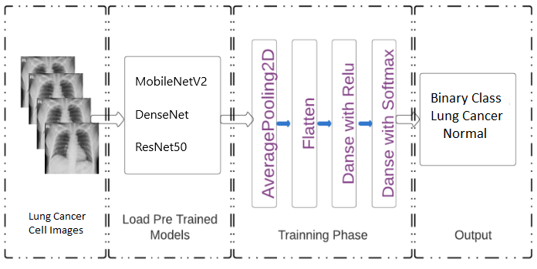
Medical DeepFake Prediction Using Deep Learning (False Lung Cancer Image Detection)
rafid.ahmed@northsouth.edu & gulam.sarwar@northsouth.edu
Rafid Ahmed & Gulam Sarwar
Supervisor: Dr. Mohammad Monirujjaman Khan
Department of Electrical and Computer Engineering
North South University, Bashundhara, Dhaka-1229
1
Introduction
4
Results and Analysis
The goal of this study is to classify lung cancer using deep learning methods.
For testing and generalization of the deep learning approach, two convolutional neural network (CNN) models and a residual neural network (ResNet) model were developed using the publicly accessible dataset.
Google Colab and Jupyter Notebook has been used to write code.
The models has overall accuracy of 99% (ResNet50),
97% (MobileNetv2) and 83% (DenseNet).
MobileNetV2 – Training and Validation Accuracy and Loss
MobileNetV2 Accuracy = 97%
2
Background
Lung cancer is a tumor that develops in any part of the lung . It is difficult, widespread cancer with a higher death ratio.
ResNet50 – Training and Validation Accuracy and Loss
ResNet50 Accuracy = 99%
Following the implementation of the MobileNetV2, we achieved a 97% accuracy and ResNet50, we achieved 99% accuracy. Validation accuracy is higher than training accuracy, and training loss is less significant than validation loss.
Lung Cancer Rates Between Male & Female
To detect Lung cancer we used deep learning method. Deep learning is a sort of machine learning and artificial intelligence (AI) that simulates how humans acquire certain types of knowledge.
5
Confusion Matrix
Annual Global Cancer Mortality
3
Dataset and System Architecture
This System’s dataset contains 22800 Histopathologic images. 2494 of Normal Histopathologic images and 2698 images of lung cancer effected Histopathologic images were used on this system. Data were spitted in three sections 70% for training, 20% for validation and 10% for testing.
Histopathologic Lung Cancer Effected Image
Confusion Matrix of ResNet50
Confusion Matrix of MobileNetV2
Deep learning performs in complicated tasks that frequently demand dealing with large amounts of unstructured data, such as picture classification, natural language processing, or audio recognition, among others. The pre-trained model was generated using RestNet50 and MobileNetV2, with minor modifications to the final layers, and a head model was developed from the basic model.
6
Conclusions
Histopathologic Normal Image
Histopathologic Lung Cancer Image Dataset
This study therefore will be valuable for the artificial intelligence research community to develop effective methods for tackling deepfakes.
ResNet50 and MobileNetV2 model performed brilliantly on the dataset.
We have claimed 99% accuracy on our system.
Our system can rapidly detect the lung cancer and patient can take precaution at early stages.
System Architecture of the Pre-trained Model

